Slide 1
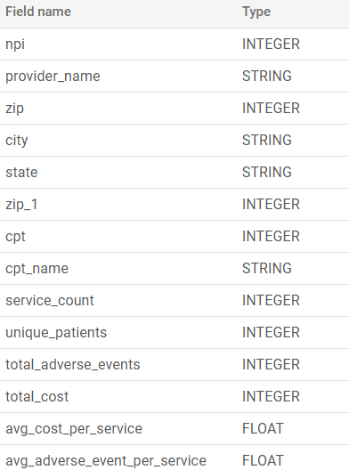
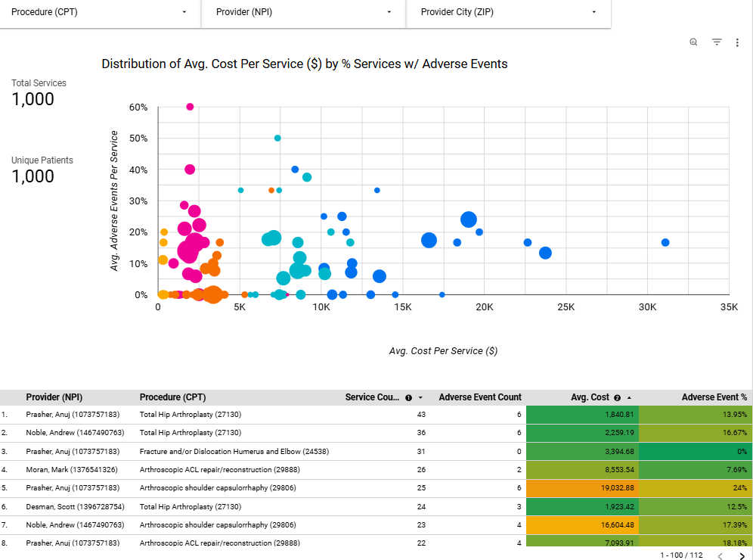
Prompt 1a
Construct an aggregate provider table(s) (using NPI as a unique identifier).
Allow Product, Clinical, and Operations teams to easily gain insight and answer business questions about these providers.
Serve as a feature store to feed machine learning models
Answers to procedures performed, costs, outcomes, and demand. *click photo for link*
PK
PK

Slide 2
Prompt 1b
Please share any high-level thinking on design decisions you made during construction of this table (no more than a paragraph is required).
Cloud Environment
Usability – non-normalized ‘flat’ tables are easier for analysts to pickup and interpret.
Efficiency – pay premium for processing and storage is relatively inexpensive – star schema joins can be more expensive than querying flat table directly.
Data Layers – flexibility and stability: staging tables for key concepts and building metrics in the analytics layer rather than in dashboards for flexibility.
Table Granularity
Row vs. Column Extensibility – CPT as a Primary Key field to use as a dimension + easier adoption of new values.
Rollup vs. Drilldown – Controlling volume and cost vs. drilling down to patient-level data.

Slide 3
Prompt 2a
Select distinct
a.patient_id
, a.gender
, a.birth_date
, date_diff(current_date(),birth_date,YEAR) as age
, p.zip
, z.zip_1
, z.zip_2
, z.city
from icon_health_demo.stg_patients a
left join `icon_health_demo.stg_encounter_details` e
on a.patient_id = e.patient_id
left join `icon_health_demo.stg_providers` p
on e.npi = p.npi
Left Join icon_health_demo.ref_zip z
on z.zip = p.zip
UNION Distinct
Select
patient_id
, gender
, birth_date
, date_diff(current_date(),birth_date,YEAR) as age
, r.zip
, z.zip_1
, z.zip_2
, z.city
From icon_health_demo.stg_referrals r
Left Join icon_health_demo.ref_zip z
on z.zip = r.zip
;
a) Construct an updated, all-time, patients table.
b) Design Notes:
Interpreted task as creating a Master Patient reference table that unifies data inputs, rather than a table for analysis.
Prompt provides assumptions to join additional details that capture missing data for the original patient table.
Add useful dimension fields like age (formula) and city (custom ref_zip table)

Slide 4

Prompt 3a
How would you advise Icon to construct a data pipeline for ingesting data (from receipt through construction of the types of artifacts you’ve provided above for the provider and patient aggregation tables)?
Data Sources
Ingestion
GCP – Data Warehouse
DBT workflow – transformations
Orchestrator – scheduling automation
Delivery
EMR - Canvas
Ad Hoc Analysis
Layer 1
SOURCE / STAGE
Layer 2
FOUNDATIONAL CONCEPTS
v_patient_all
WORKSPACE R & D / Ad Hoc Work
Product - Telescope
Looker Dashboards
Layer 3 INSIGHTS
v_patient_referrals
v_provider_metrics
Claims
Python Stitch
Flat Files S3
JSON
etc.
Queries
BI Tool
Etc.
Outputs – FHIR, APIs, other reports
Clean version of concepts used across analyses. Type 2, Error handling E.g. Clean claims, encounters, reference tables, and centralized Provider / Patient rosters.
Analysis-focused Data marts driven by business content areas for reporting, ad hoc analysis, and exporting. Relies on clean foundational data
Staging source datasets with all values – limited type and content transformation. Type 1 – Backup + Replace files available.

Slide 5
Prompt 3b
What challenges might we face as the variety, volume, and velocity of these data sources increases? How would you advise addressing these challenges?
Challenges:
Cloud Cost Increase – can scale fast as new data sources are added, models are built, and user queries are executed.
Maintenance Level of Effort Increase – will also go up as these new capabilities are added. The more frequently a job runs, the more potential for error handling and maintenance which will erode new development timelines.
Complexity – of the data model will grow and knowledge transfer can get lost with turnover.
Strategies to Mitigate Challenges:
Prioritize data frequency and recency – backup and store historical data that is no longer being used in a way where it is not being constantly queried. Select update timelines that reflect business needs and avoid needless refreshes for better input alignment and maintenance work blocks.
Enforce Code Management, Code Reviews and Documentation Practices – Tools to backup all code, like GitHub, will help keep code organized. Can help avoid losing legacy knowledge from turnover. The simpler and more accessible the tool, the better.
Strive to Build Enterprise Solutions – Data Warehouse style / structure guidelines, development / production release cycles, and automation requirements for reporting will all help build data products that run smoothly and can be managed. Developing ad hoc queries can get you information very quickly (excellent for R&D). Use this to build stable solutions, don’t let the amount of these queries pile up and get lost.

Slide 6
Prompt 3c
What other data sources would be helpful to acquire to help serve the ends described above?
In addition, ADT (HIE) Feeds, EMR Data, Claims Data you could leverage:
Medicare Advantage – CMS files (e.g. MMR for patient contract and demographics) – can be difficult to get as insurer manages release to PCPs and likely a gatekeeper for specialists too.
PCP / ACO / Insurance data – receiving information from partners related to patient demographics.
Third Party Documentation Mining – Zus Health, Appian, etc. who find additional diagnosis and service documentation.
Postal Code Lookups, CPT Lookups, NPI Lookups, Diagnosis Code Lookups – All can be used to improve data quality. I added a few of these ad hoc to my example data model to improve outputs.
Proprietary Products – Systems that patients interact with beyond the EHR, like OrthoPass / Telescope data.

Slide 7
Appendix A: Source Data Profiling & Simplification
Review the datasets to evaluate completeness:
Updated missing provider NPI details
Manual w/ Google – only two missing fields – typically would use NPI reference dataset.
Added CPT Descriptions for cleaner insights
Vlookup – typically would use CPT reference dataset for larger volume.
Added an adverse_events_ind
Vlookup to check that each adverse_event had a matching encounter
With SQL – would use a left join to confirm matches and case statements to create indicator fields.
Added an age field to patient details using an excel formula
Age is better for segmentation and is easier to conceptualize.
Also Re-added as a formula in SQL
* Removed all formulas in excel sheet to maintain values and eliminate errors when importing.

Slide 8
Appendix B: Attachment Index
Data_sets_clean.xlsx
Clean version of data prompts used for the stg tables in BigQuery
SQL Scripts.txt
All The SQL written to build the datasets
Demo Dashboard – link to web
Link to Google Looker Studio – using BigQuery datasets (found in SQL scripts file) as data sources.

